Slide 1
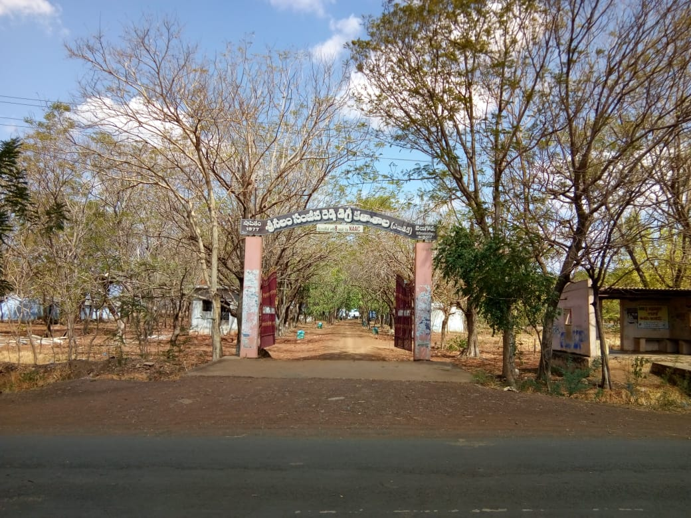
The starting point of 31st China Sodha Yatra

Slide 2
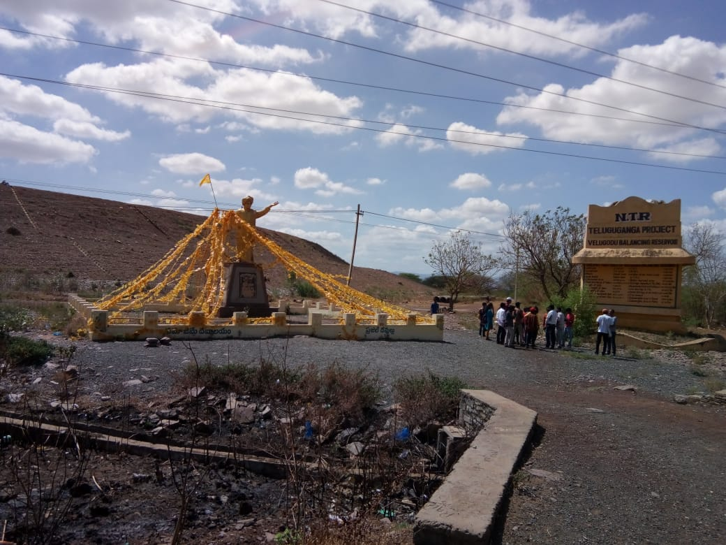
Foundation stone layed down area of Veligodu Balancing Reservoir, where NTR statue placed

Slide 3
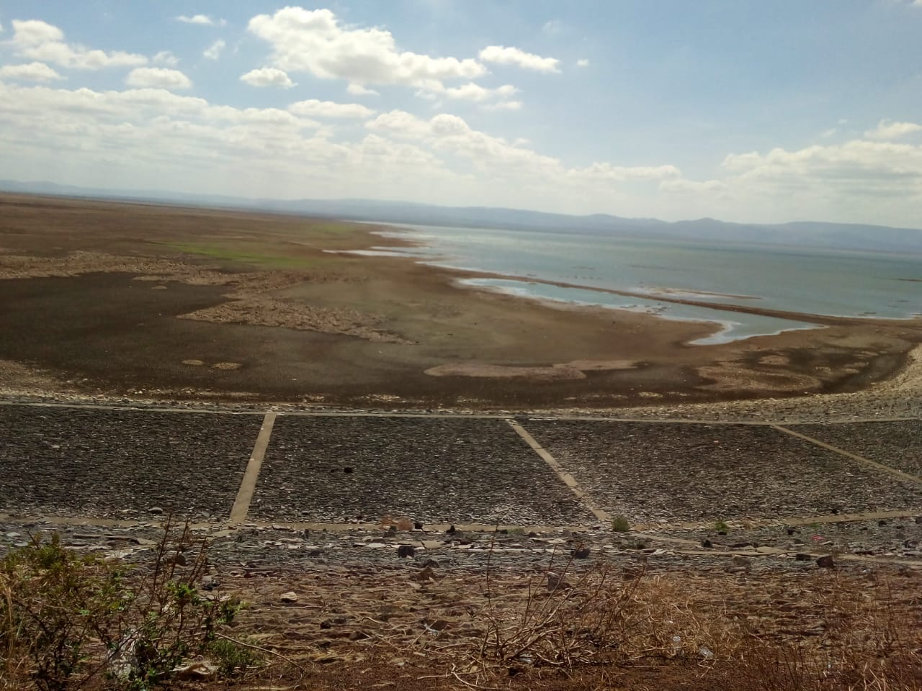
Low water level in Veligodu Balancing Reservoir

Slide 4
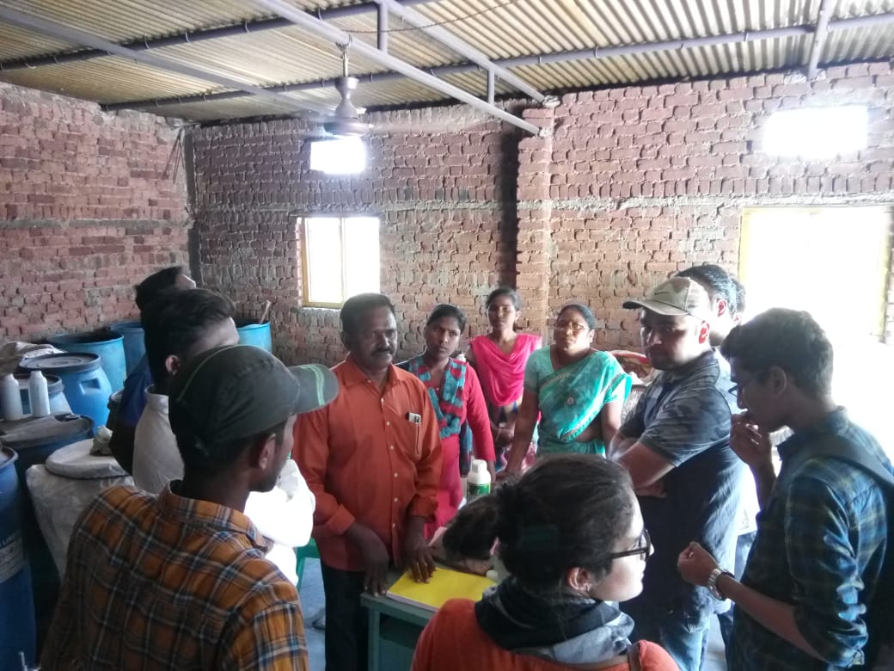
Manjunatha organics firm of Sri Venkata Krishnudu garu in veligodu

Slide 5
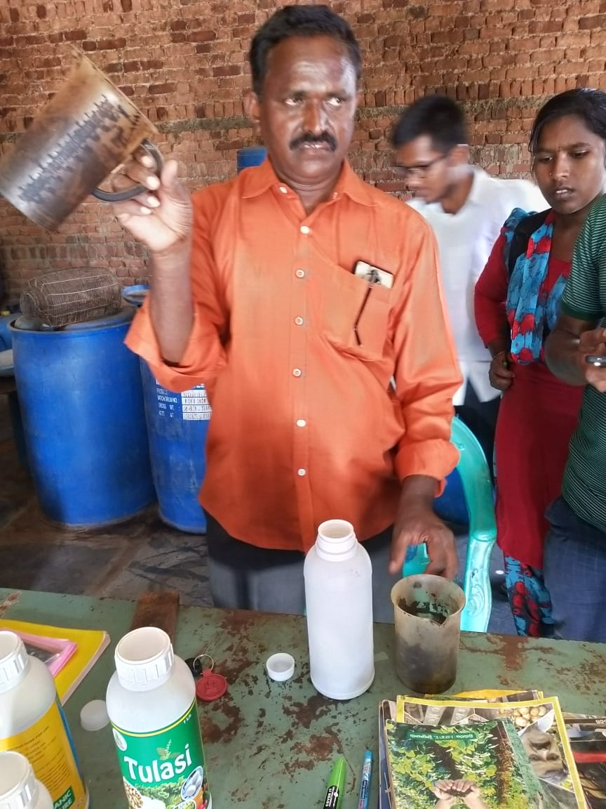
Venkata krishnudu garu explaining the making of Tulasi organic manure

Slide 6
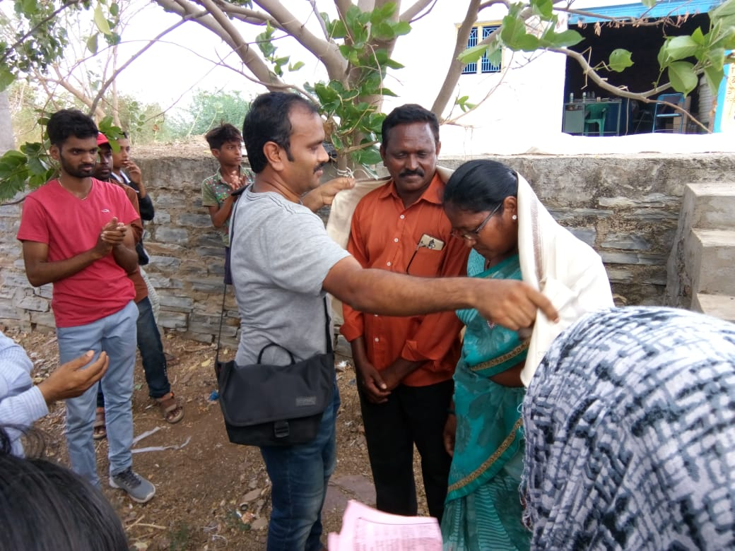
Felicitation to Venkata krishnudu gari couple by co-yatri

Slide 7
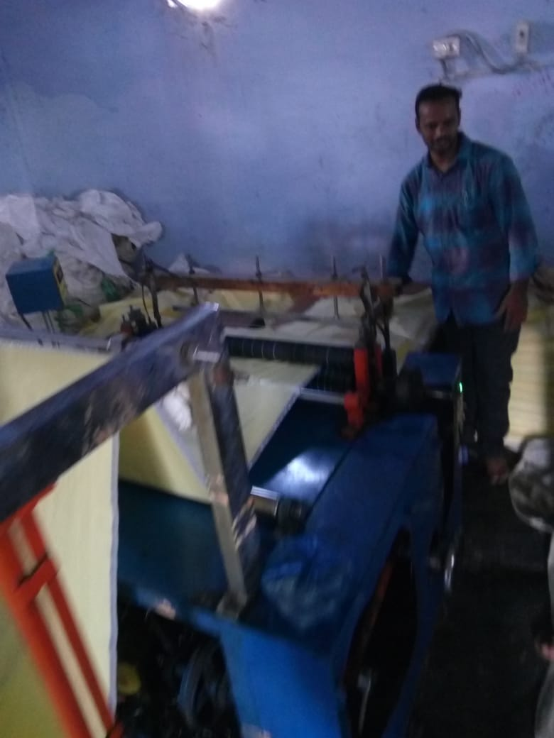
Automatic cutting machine for bag material
in Narasimhaiah traders unit of veligodu

Slide 8
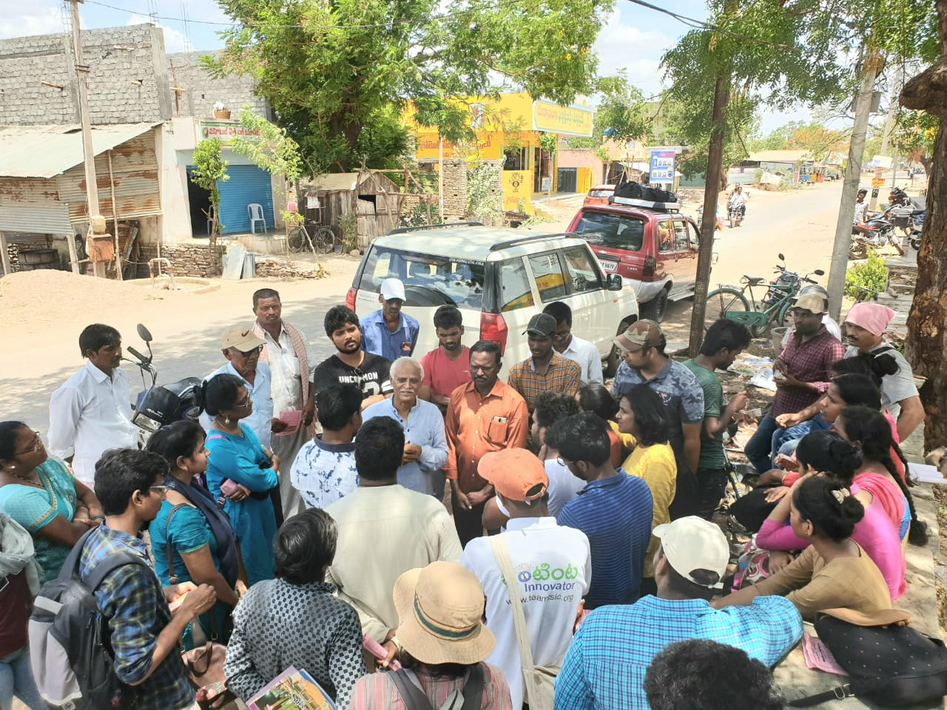
Ganesham garu explaining the importance of
exploring village knowledge

Slide 9
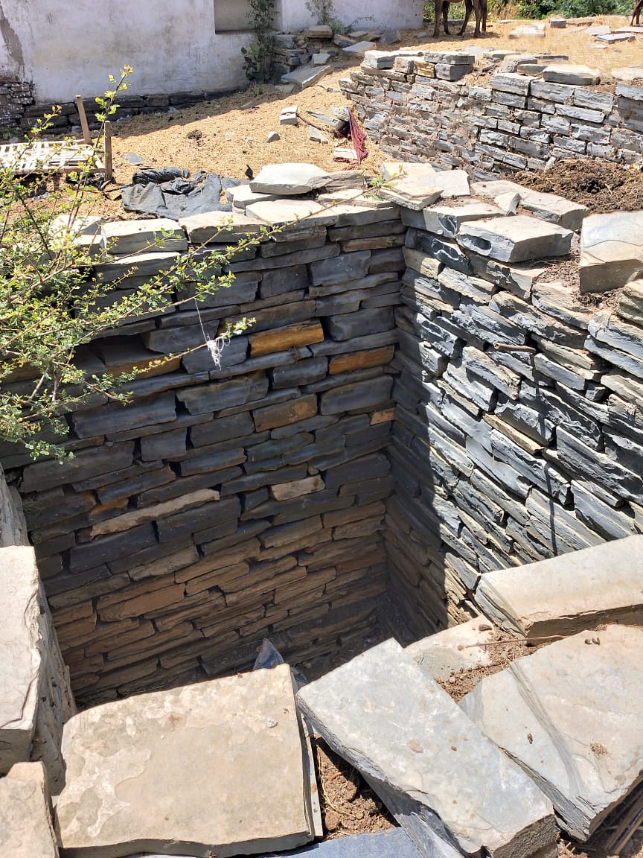
Construction of village well with Palugudu Rayi

Slide 10
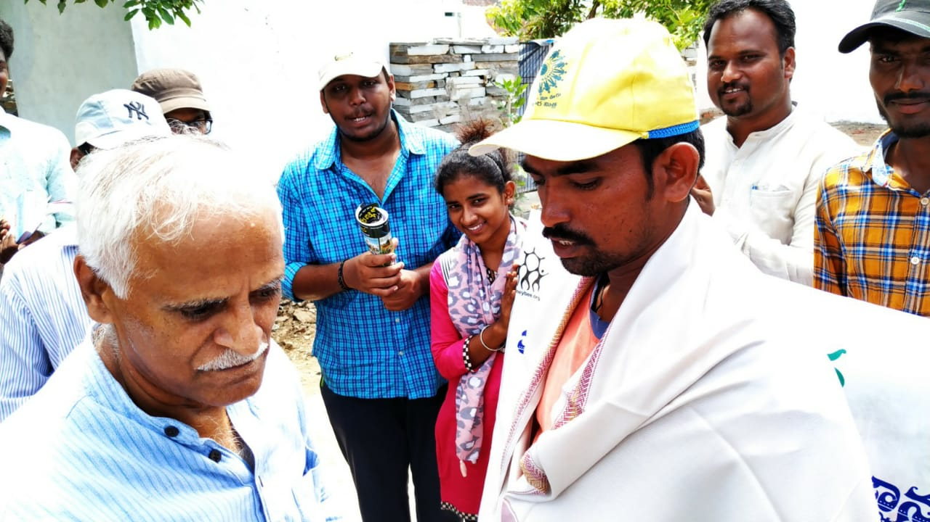
Ganesham garu felicitating
Palugudu Rayi finishing worker Basha

Slide 11
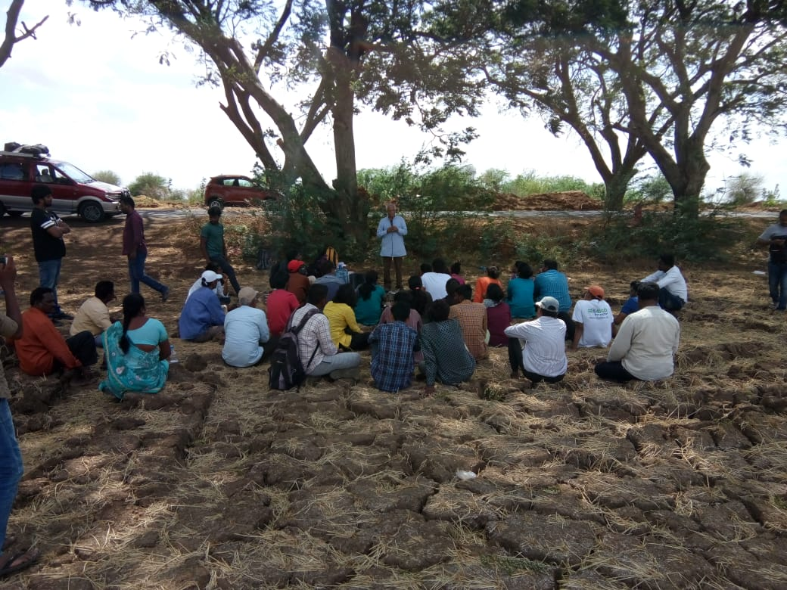
Ganesham garu telling the
success story of Nunnam Tirupatirao

Slide 12
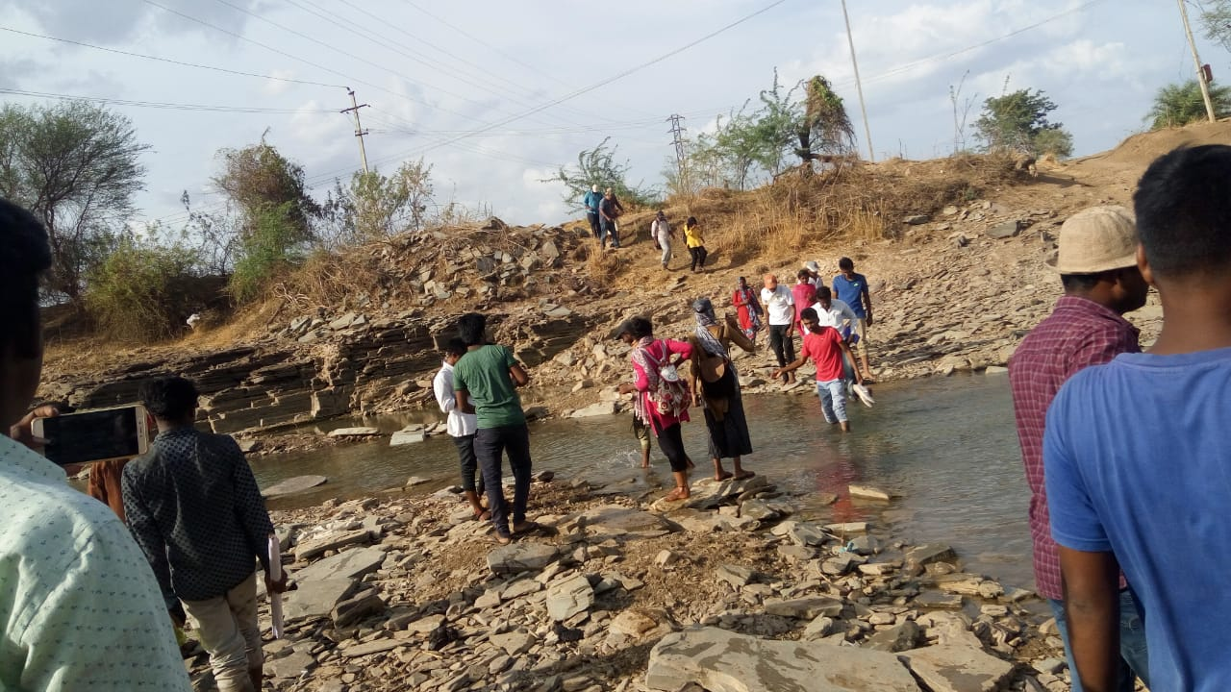
Sodha Yatris crossing the Galeru River near Ayyavaripalli

Slide 13
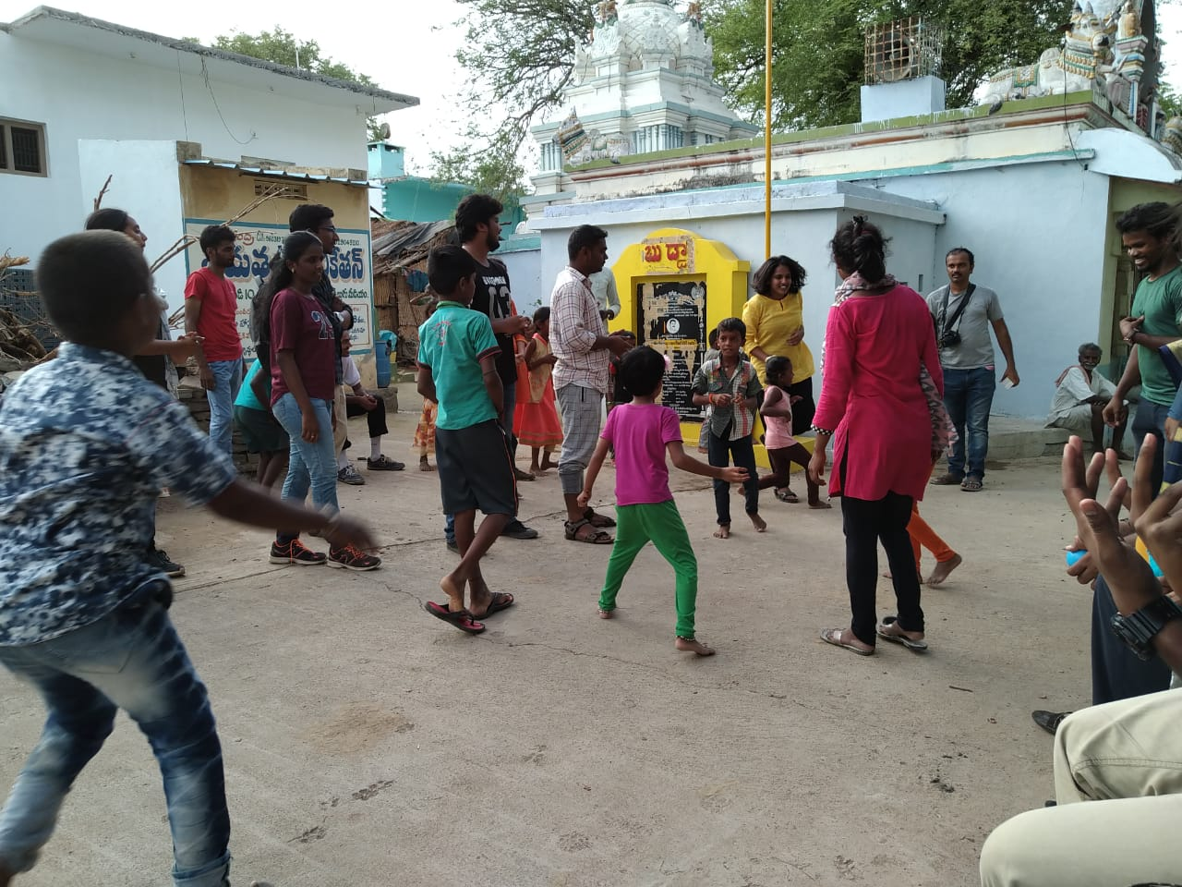
Sodha Yatris conducting games to
village children in ayyavaripalli village

Slide 14
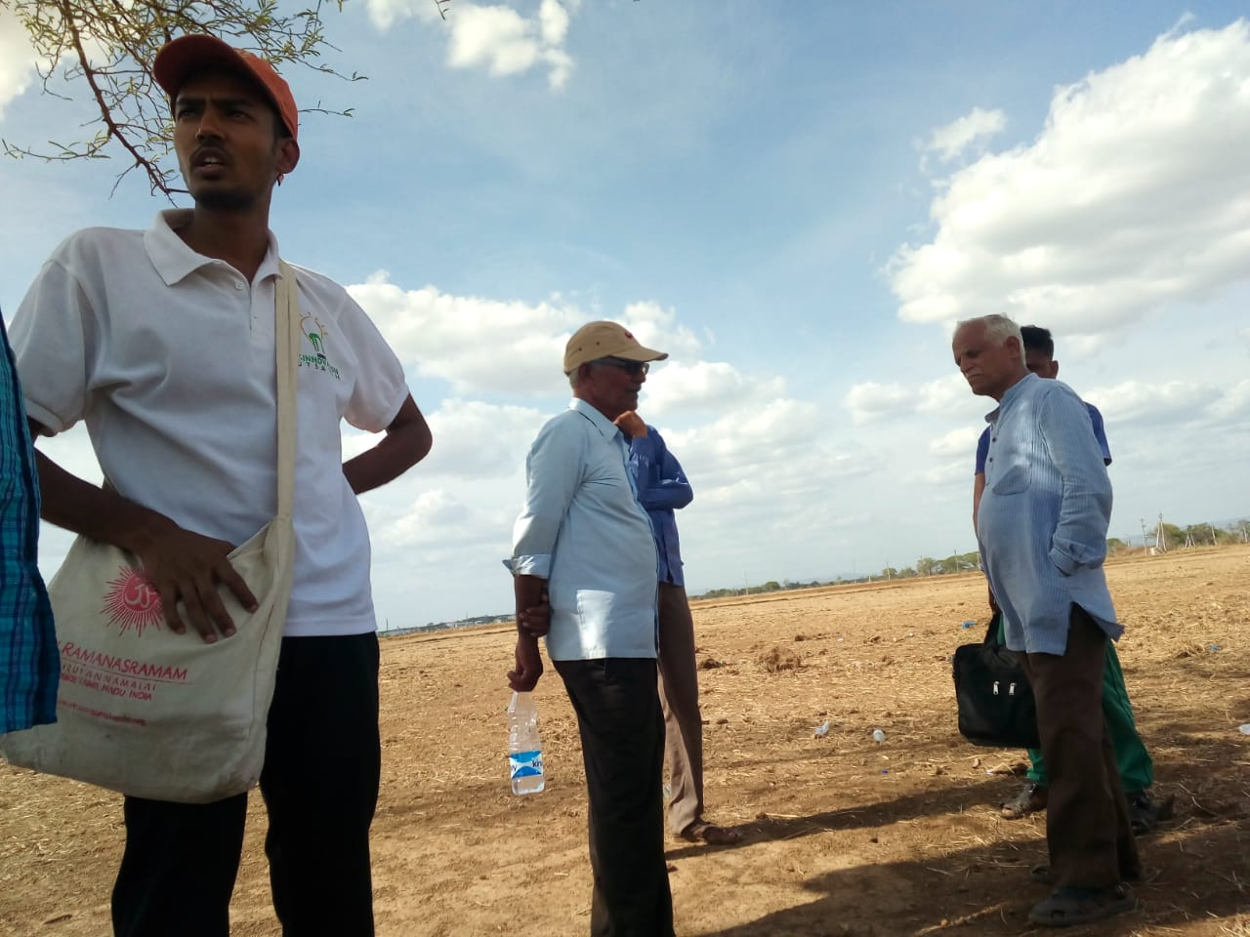
Ganesham garu discussing with one of the
grassroot innovators of palle srujana Abdul Kareem garu

Slide 15
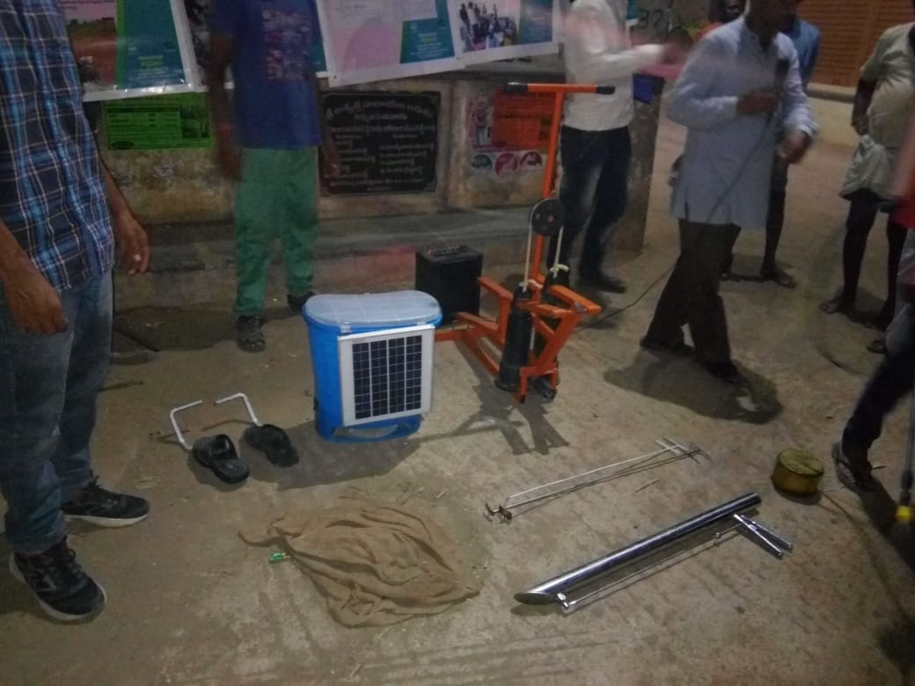
Grassroot innovation products displayed in a village

Slide 16
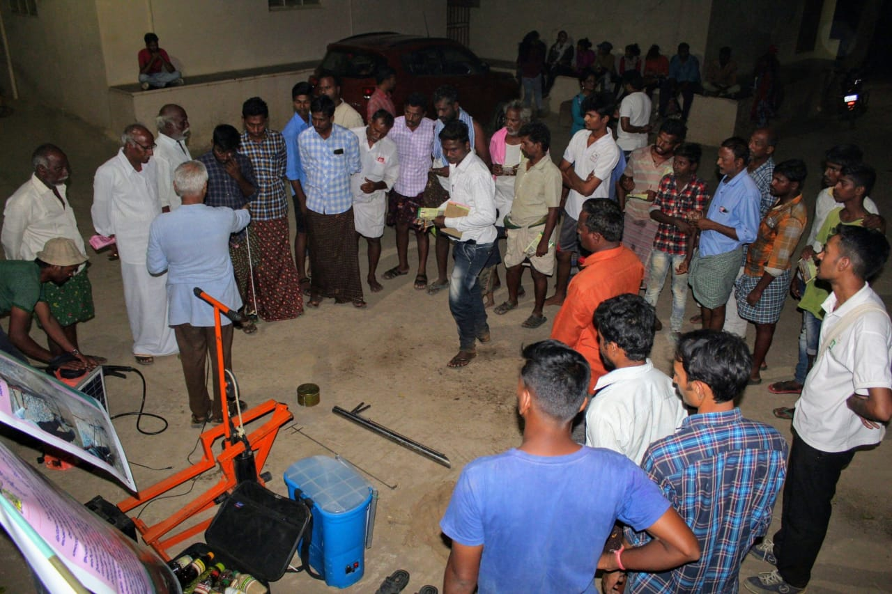
villagers are keenly listening about village innovations

Slide 17
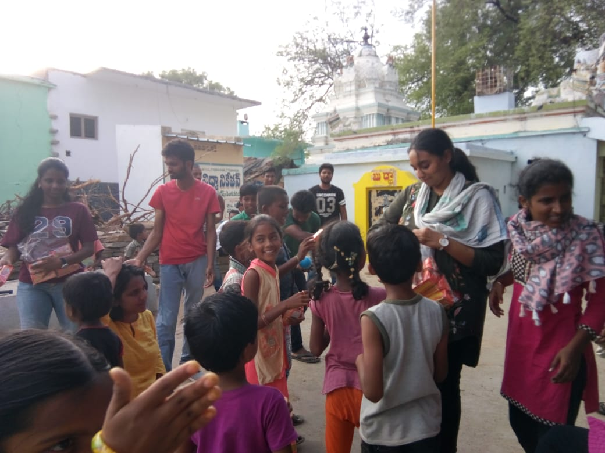
Yatris are distributing biscuits to village children

Slide 18
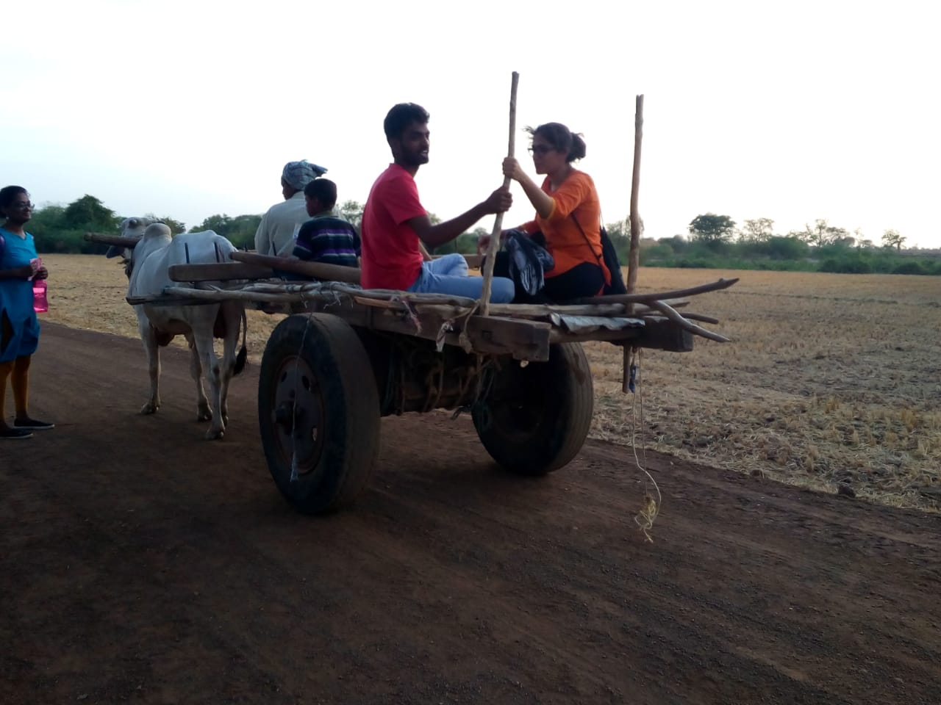
Some of the yatris are experiencing the bullock cart ride

Slide 19
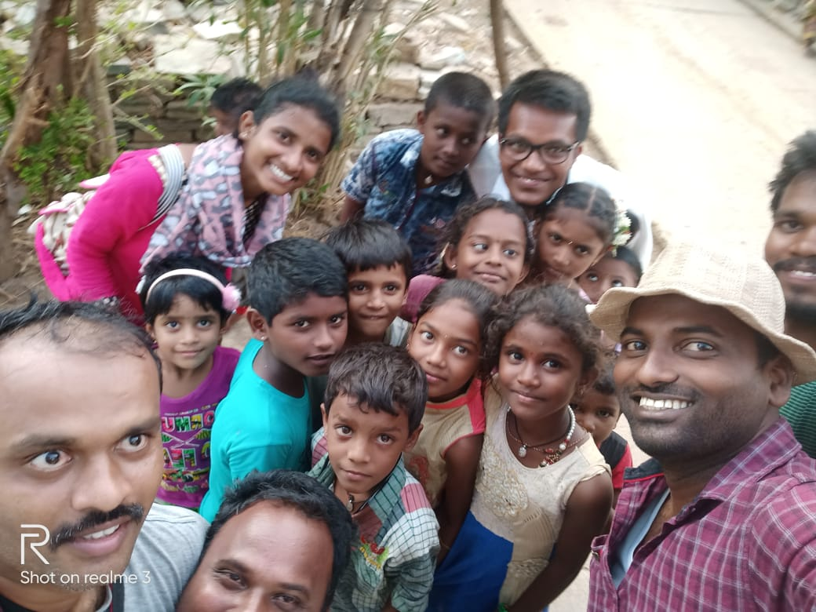
Co-yatris with village children

Slide 20
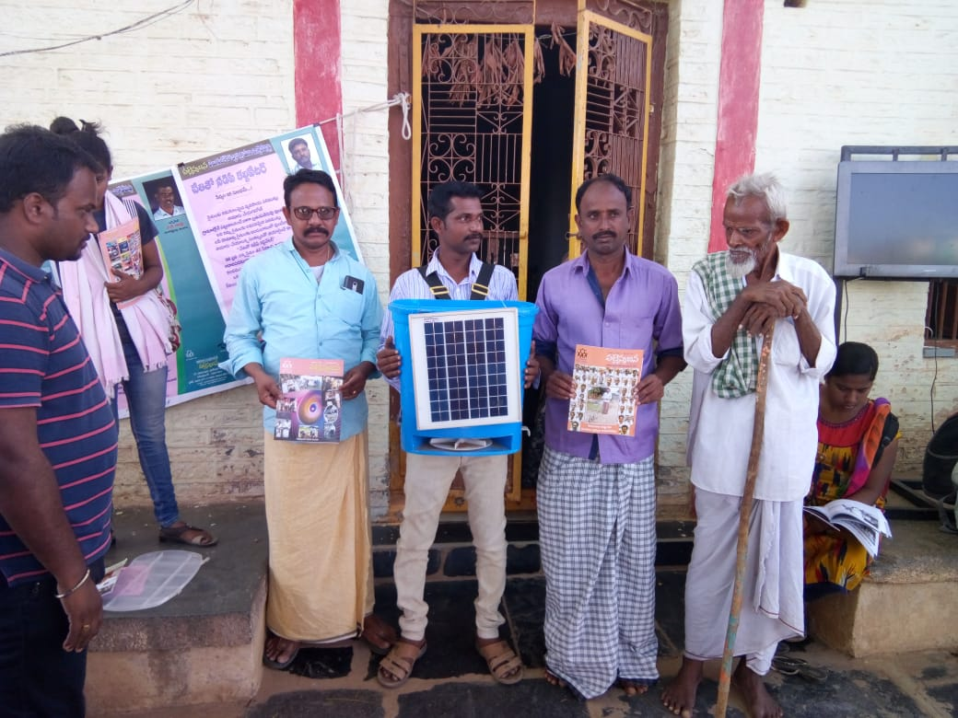
Villagers involvement in display session

Slide 21
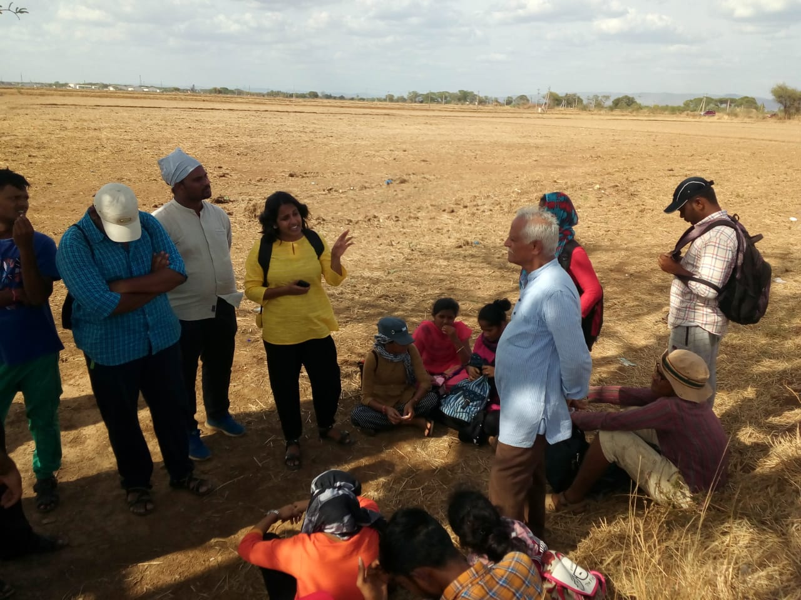
Co-yatri asking doubts to Ganesham garu

Slide 22
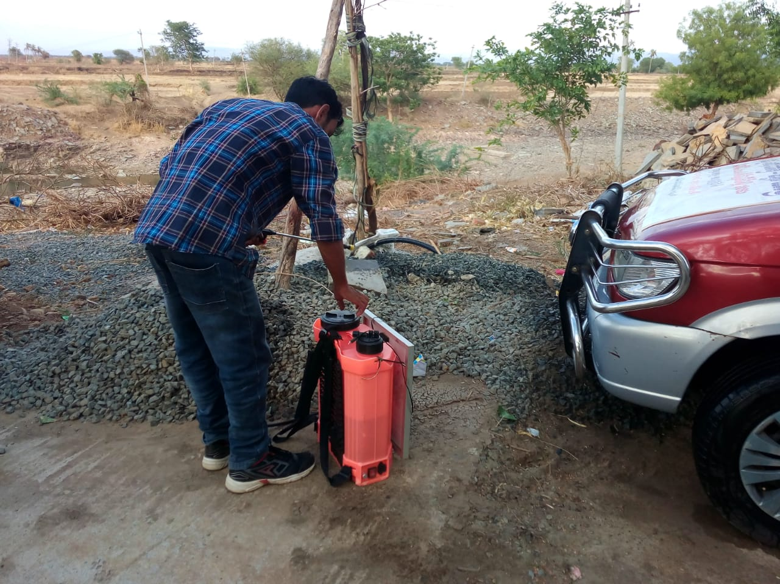
Co-Yatri is preparing the Grassroot innovation product
for display in village session

Slide 23
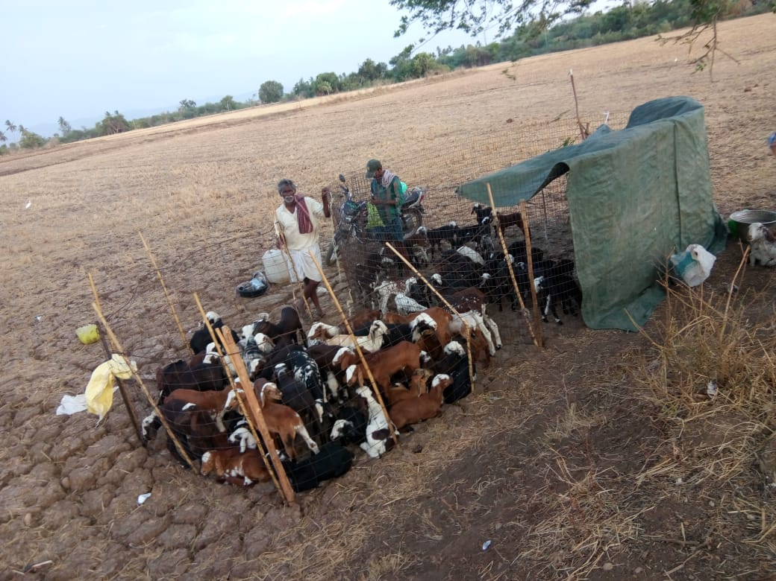
Dwelling place of goat cattle in a village field

Slide 24
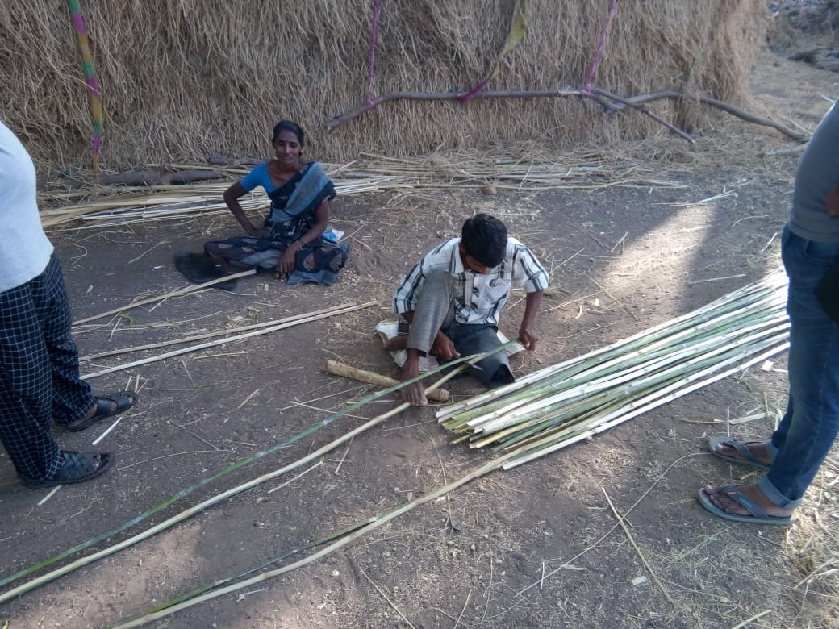
Preparing bamboo for making of fencing (Tadika)

Slide 25
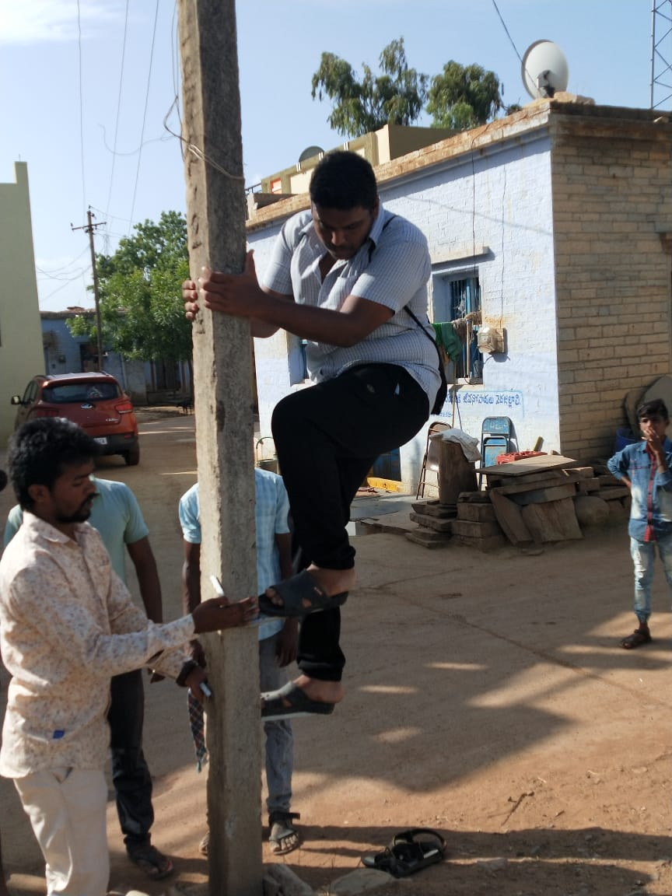
Sodha yatris demonstrating the working of pole climber unit

Slide 26
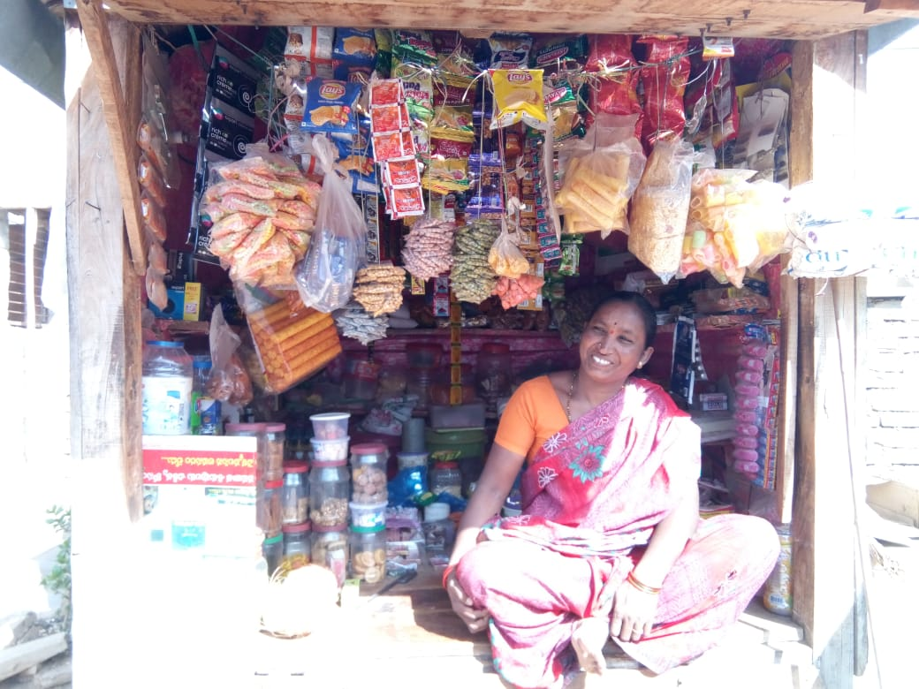
Systematic arrangement of more items in a small shop.
Best example of workplace management in villages

Slide 27
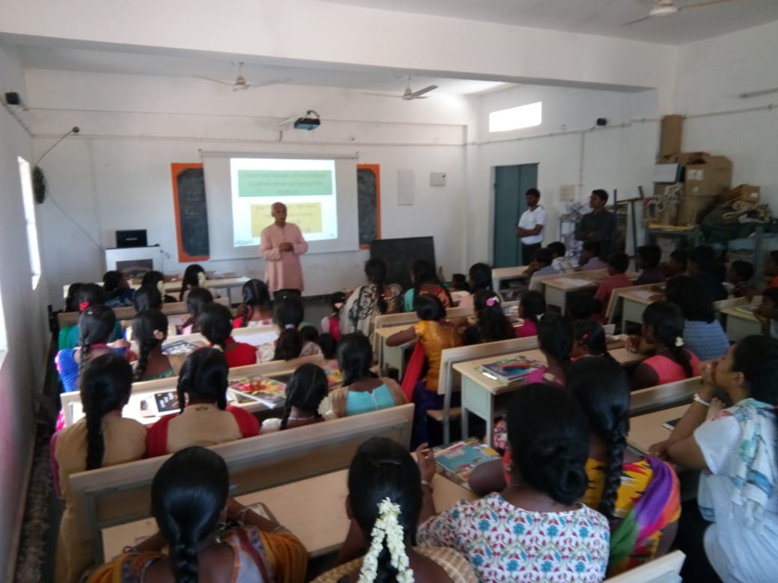
Ganesham garu taking session to school children
regarding creativity and innovation (Ignite awards awareness)

Slide 28
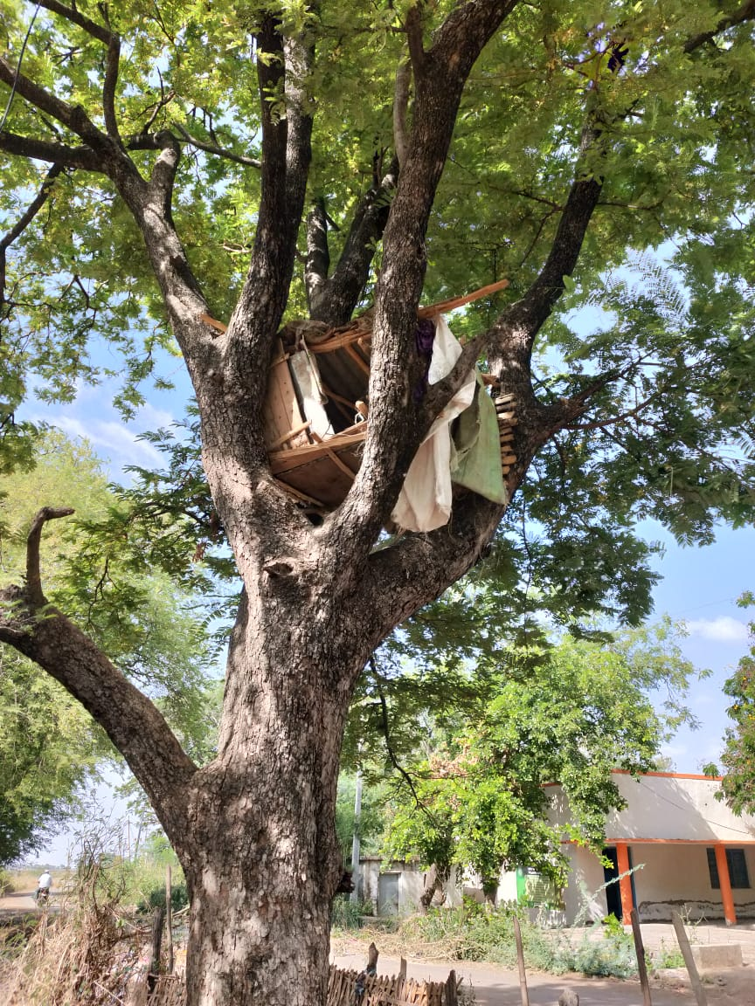
Pigeon nest made on a tree by a village boy in Narayanapuram

Slide 29
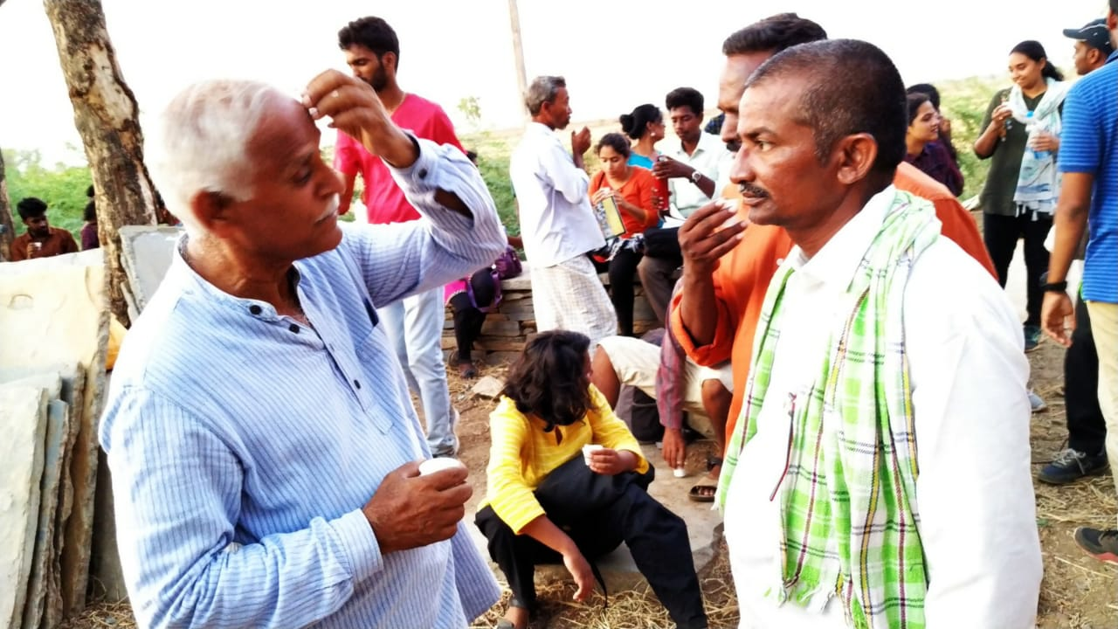
Ganesham garu interacting with a villager
(in the background ,farmer who explained us about turmeric rhizomes curing process)

Slide 30
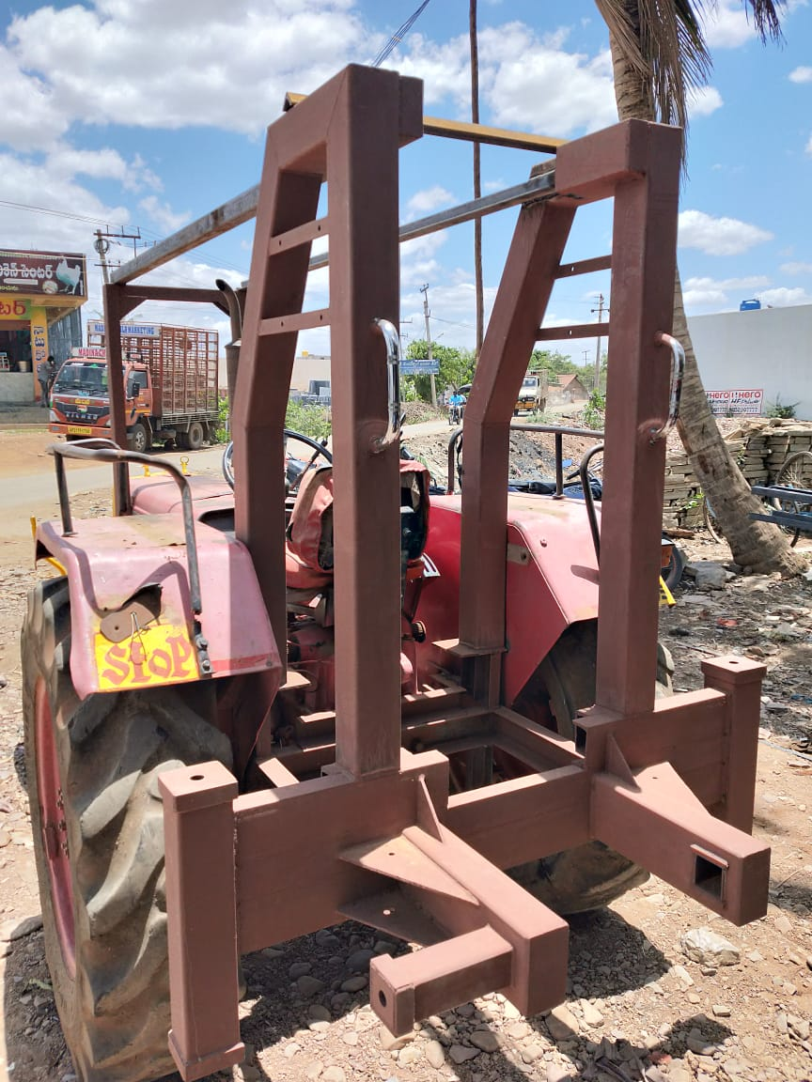
Borewell unit structure attached to a tractor in a village
(Necessity is the mother of invention)

Slide 31
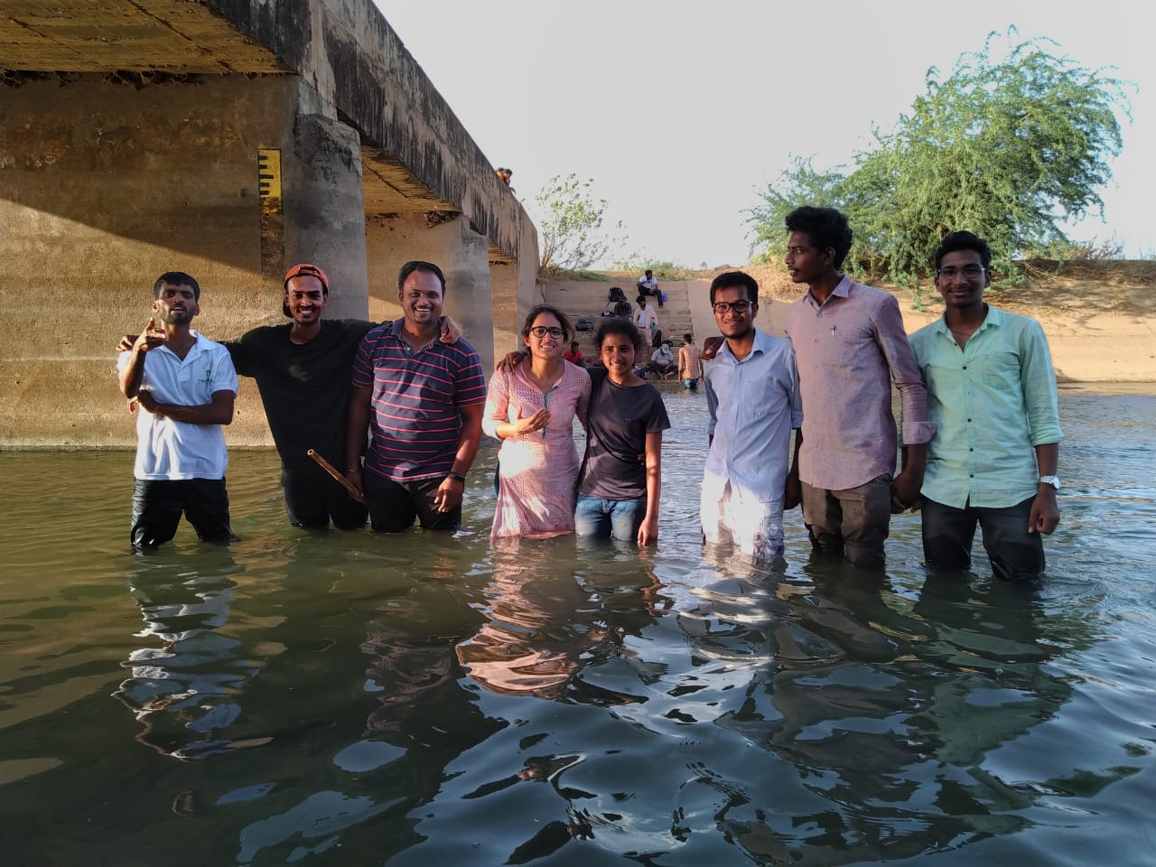
Yatris crossing KC Canal

Slide 32
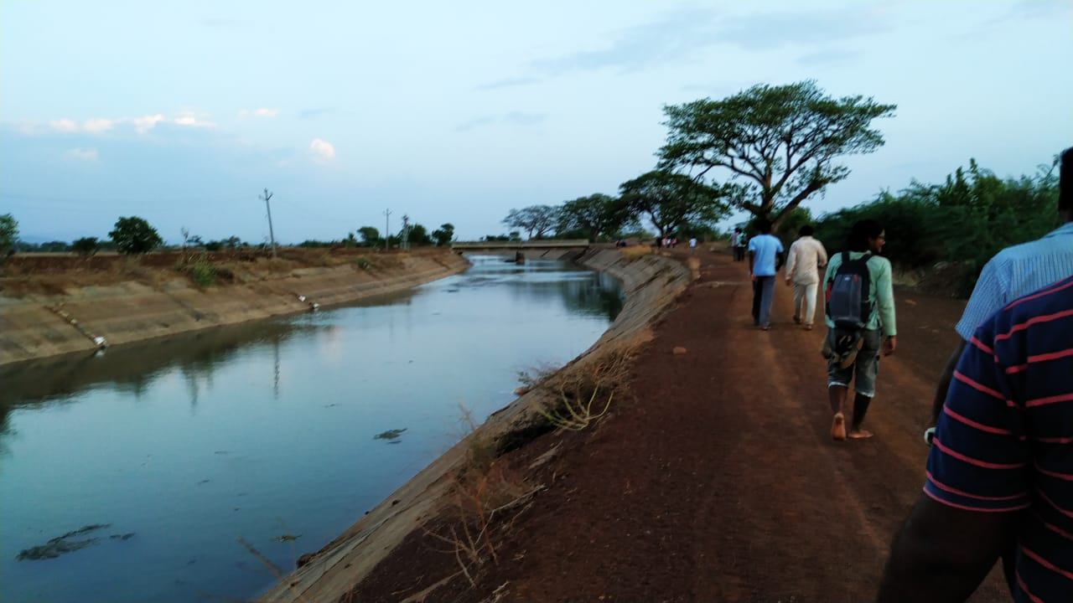
Sodha yatris walking along the right bank of the KC Canal

Slide 33
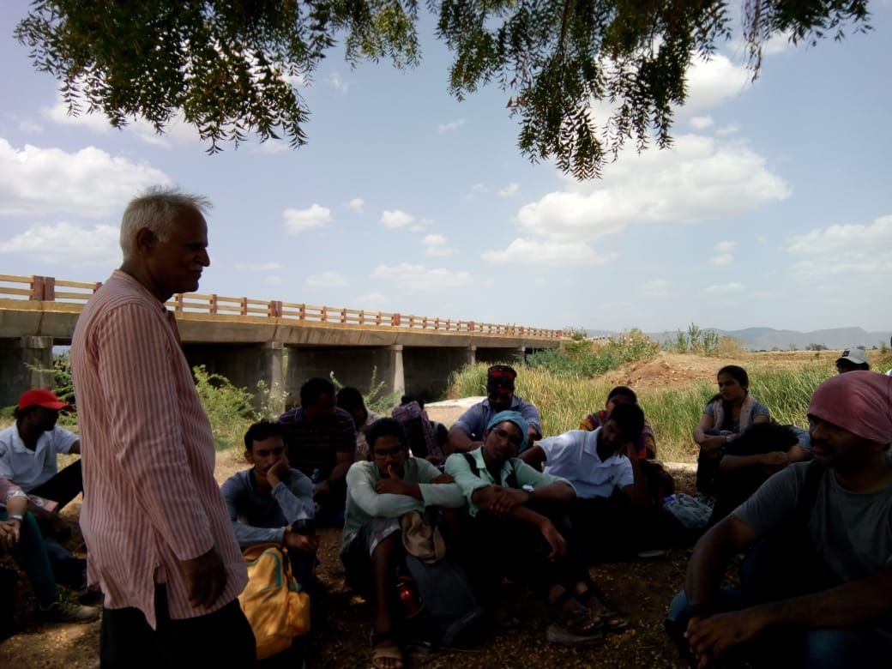
Brainstorming session

Slide 34
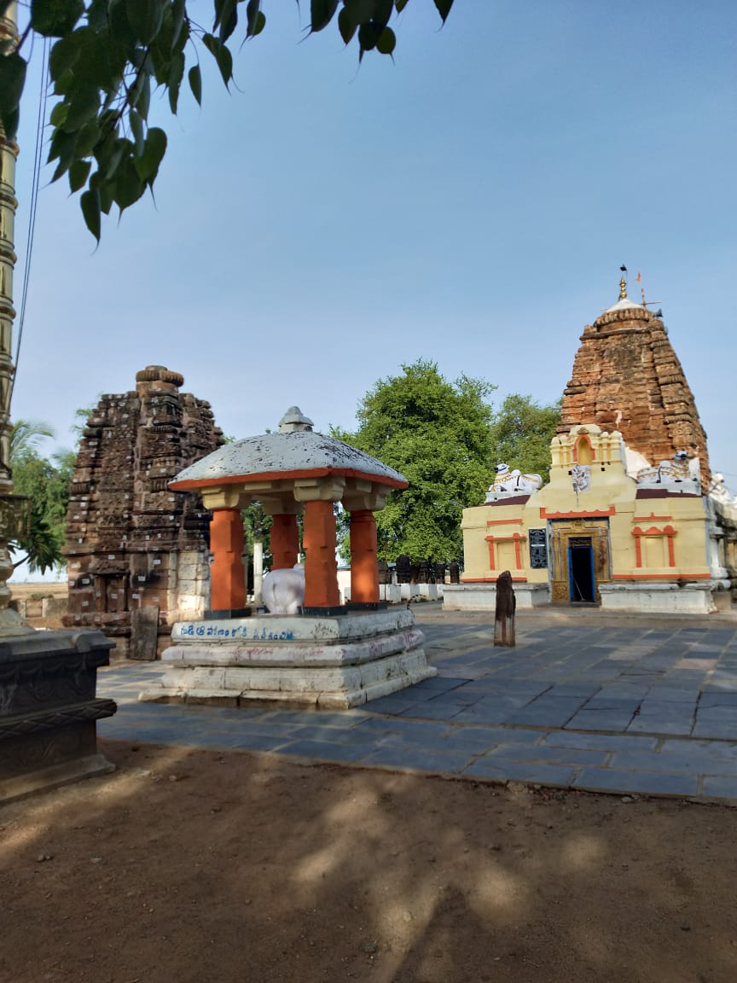
Sivanandi Temple in KadavalaKaluva Village

Slide 35
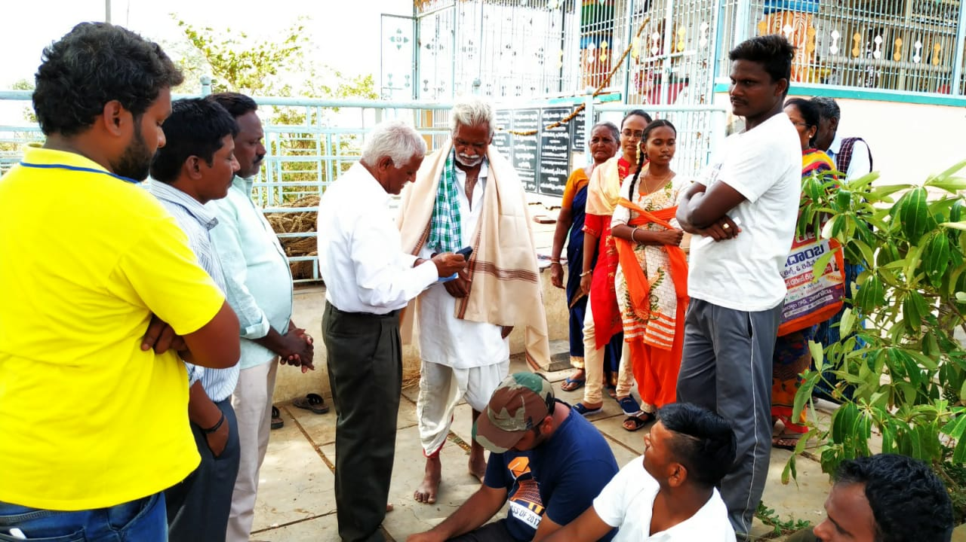
Felicitating Mulika Vaidyudu Sri Venkata Swamy Garu
of Tammadapalli Village

Slide 36
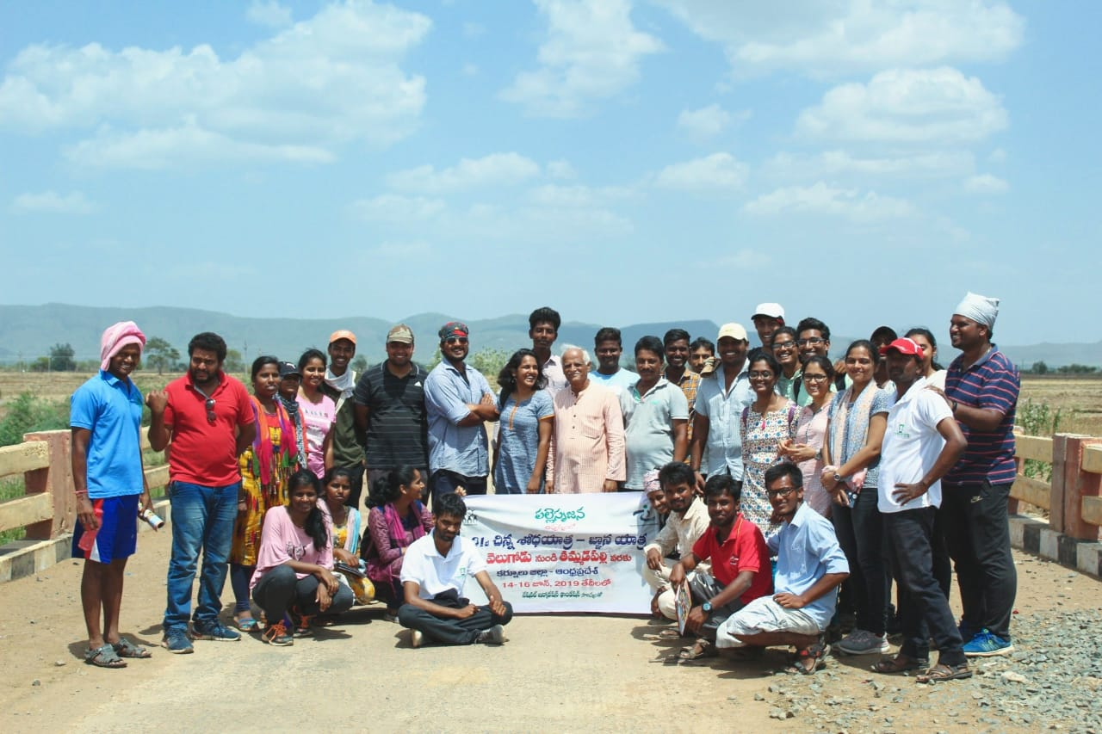
Sodha Yatris with Brigadiar Sir

